Slide 1
ILSMC: a phylogenetically aware SMC to infer the evolutionary history of species
Iker Rivas-González

Slide 2
Overview
Incomplete lineage sorting (ILS)
CoalHMM
SMCs
ILSMC
The hidden states
The CTMCs
The transition probability matrix
Simulating from the model
Discussion

Slide 3
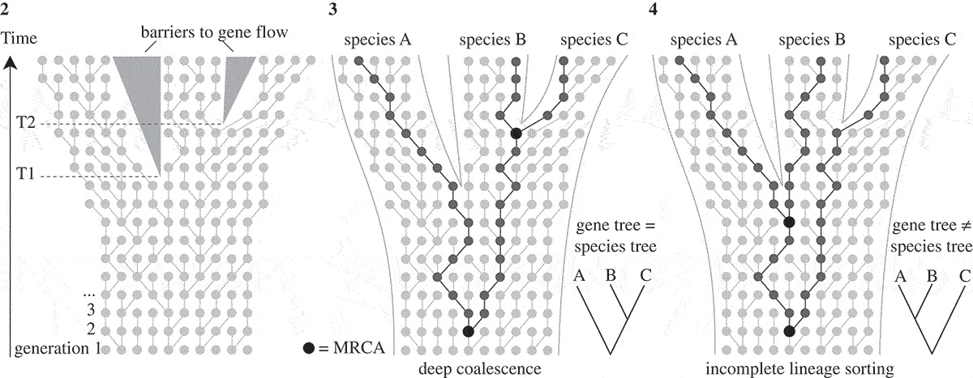
Incomplete lineage sorting (ILS)
Modified from Leliaert et al. (2013)
Notes:
- Three species, two speciation events.
- If 1st coal between T1 and T2 -> gene tree = species tree
- If 1st coal escapes T2 -> maybe gene tree != species tree
- This is called ILS.
- Usually regarded as an obstacle for phylogenetic reconstruction.
- But valuable -> information-rich about speciation times and ancestral population sizes.

Slide 4
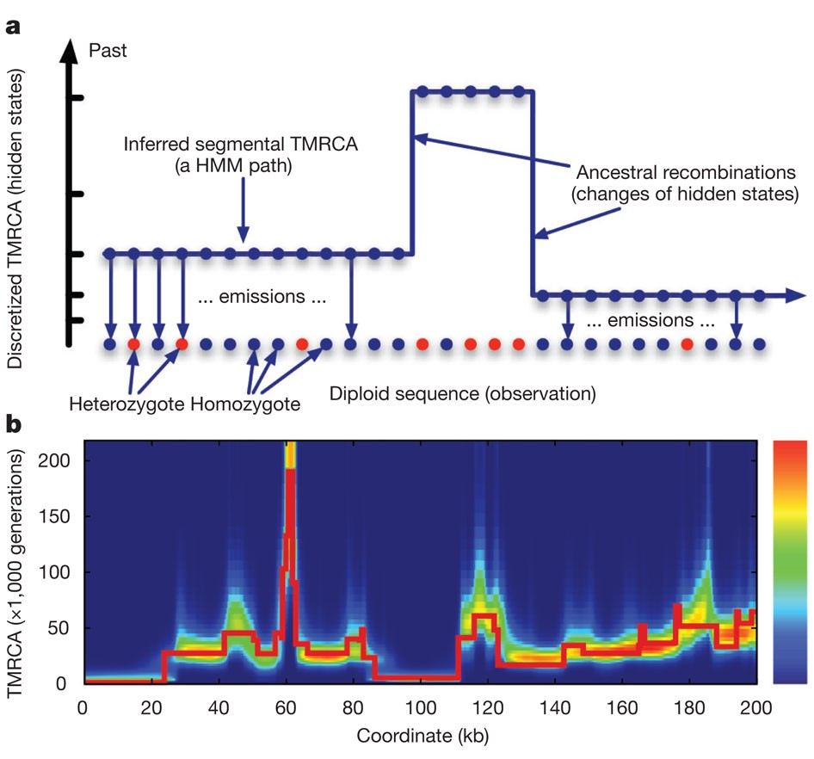
HMMs
Li and Durbin (2011)
Notes:
- Population genetics parameters have been inferred using HMM.
- Hidden states are phylogenetic trees / coalescent times.
- Observed states are sites along the genome.

Slide 5
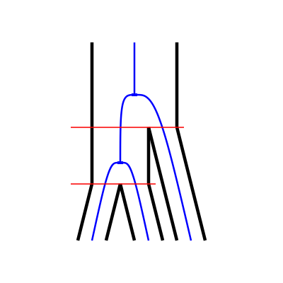
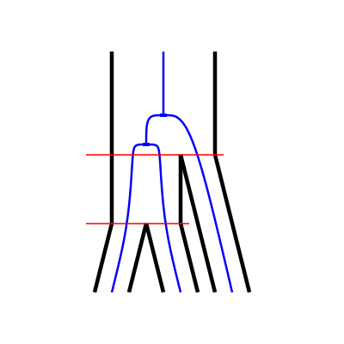
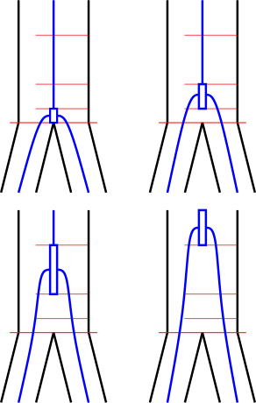
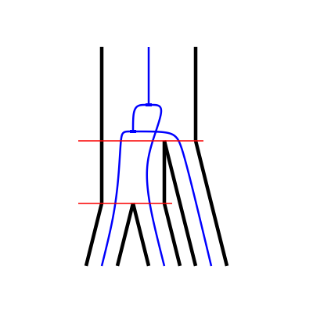
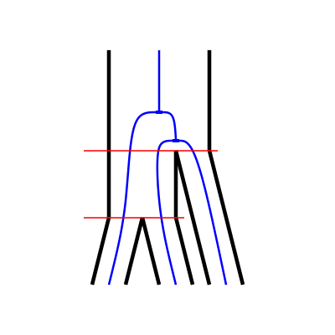
HMMs
V0
V1
CoalHMM
SMCs
V2
V3
Notes:
- Sequentially Markovian coalescents
- Hidden states are discretized time intervals.
- Useful to model changes in Ne through time.
- Drawback: only one coalescent.
- CoalHMM:
-hidden states are phylogenetic trees
- V0: canonical topology
- V1, V2, V3: the others deep coalescence
- V2, V3: alternative topologies (ILS).
- Useful to infer spec times & ancestral Ne.
- Drawback: biased parameters.

Slide 6
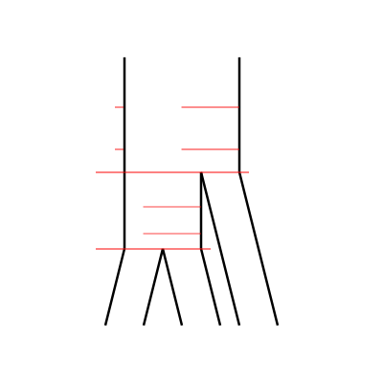
ILSMC
Extract the ILS information CoalHMM-style
Parameterize with discretized time intervals SMC-style
Notes:
- Combine the two approaches.

Slide 7
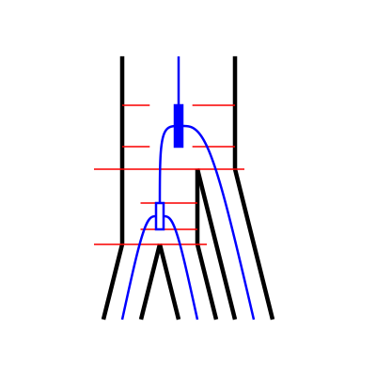
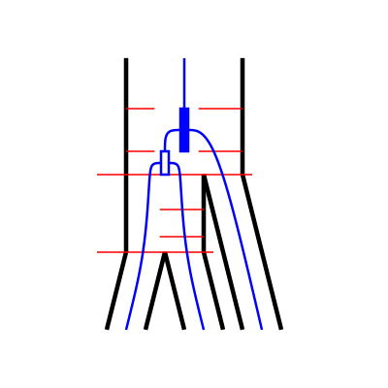
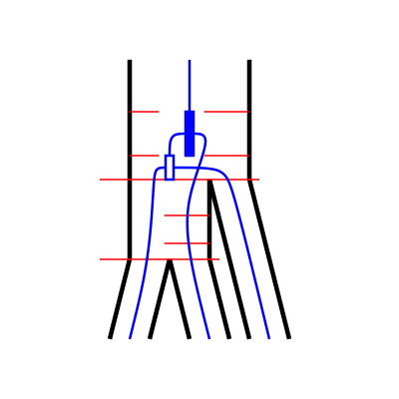
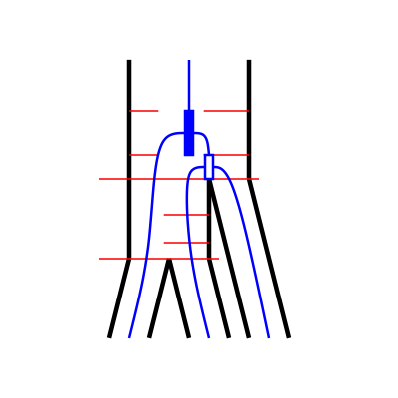
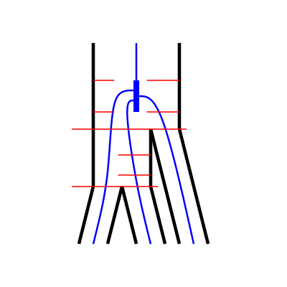
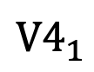
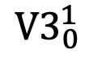
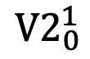
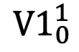
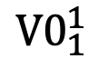
The hidden states
$${V0}_{1}^{1}$$
$${V1}_{0}^{1}$$
$${V2}_{0}^{1}$$
$${V3}_{0}^{1}$$
$${V4}_{1}^{ }$$
Notes:
- New hidden states: phylogenetic trees with two discretized coalescent events.
- V0 -> set of V0 states, each with a combination of coal times.

Slide 8
The hidden states
$${V0}_{1}^{1}$$
$${V1}_{0}^{1}$$
$${V2}_{0}^{1}$$
$${V3}_{0}^{1}$$
$${V4}_{1}^{ }$$
Parameterized by:
Split times.
Ancestral effective population sizes.
Number of intervals for discretization.
Recombination rate.
Mutation rate.
Notes:
- Parameterization = inference.

Slide 9
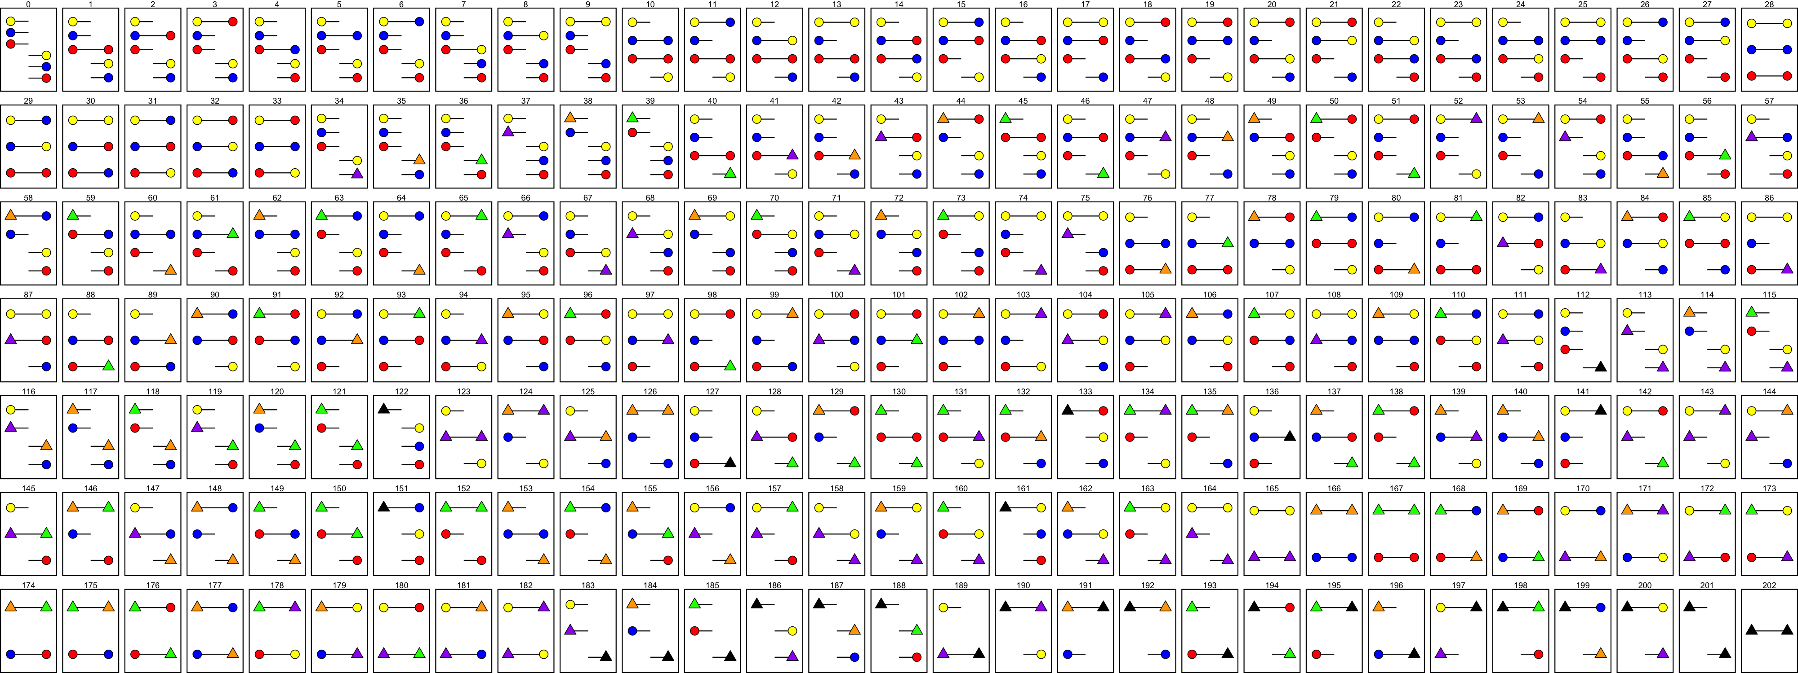
The CTMCs
Three-sequence CTMC
Two-sequence CTMC
One-sequence CTMC
One-sequence CTMC
One-sequence CTMC
Notes:
- ILSMC is built by interconnected CTMCs (continuous-time Markov chains).
- These are needed to get the transition probability matrix of ILSMC.

Slide 10
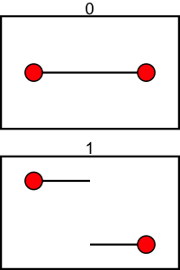
The CTMCs
1C
1R

Slide 11
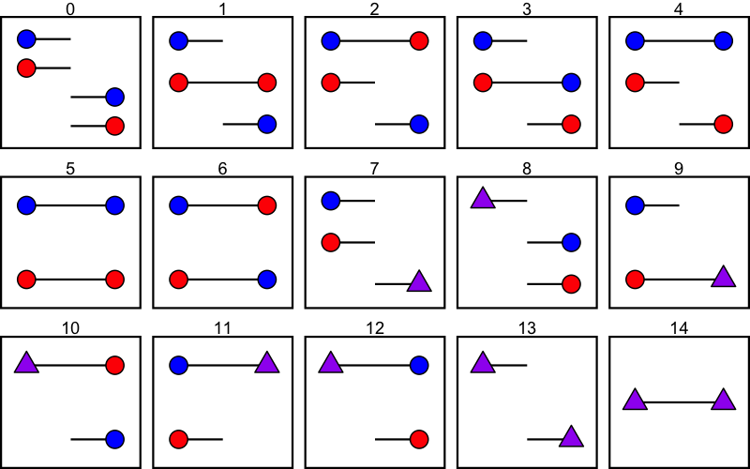
The CTMCs

Slide 12
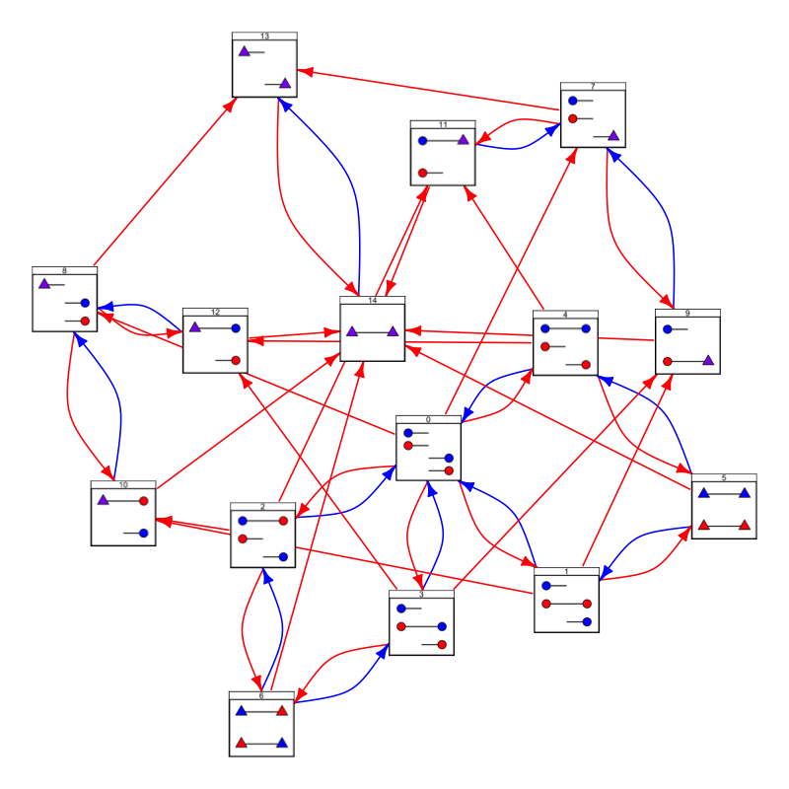
The CTMCs

Slide 13
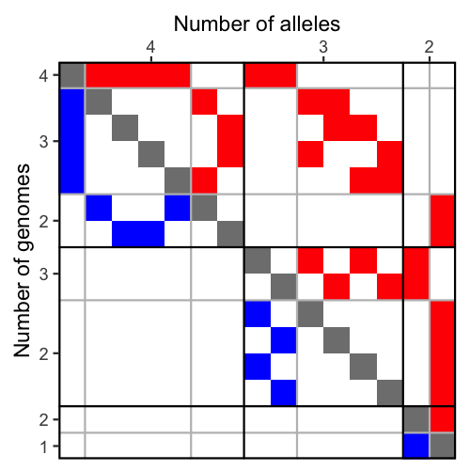
The CTMCs

Slide 14
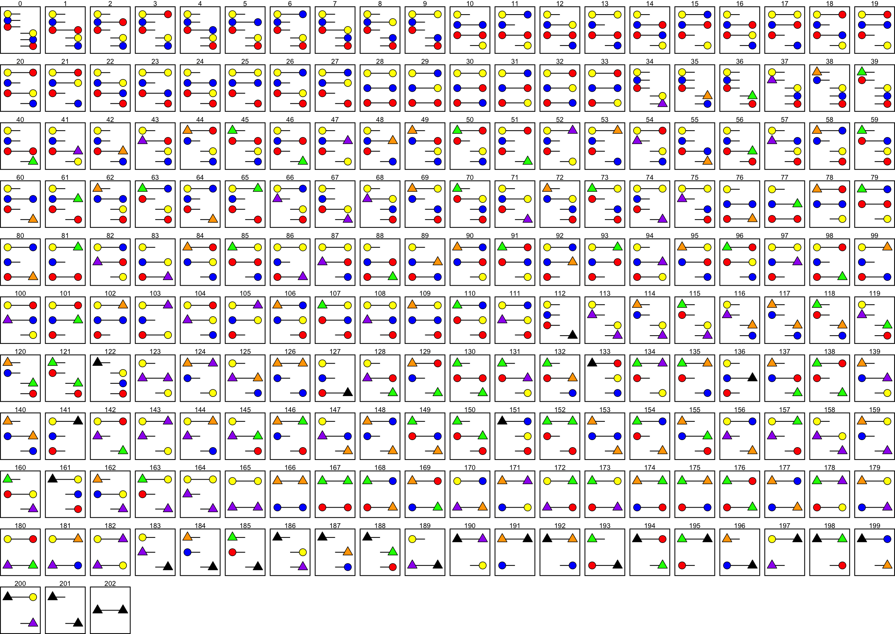
The CTMCs

Slide 15
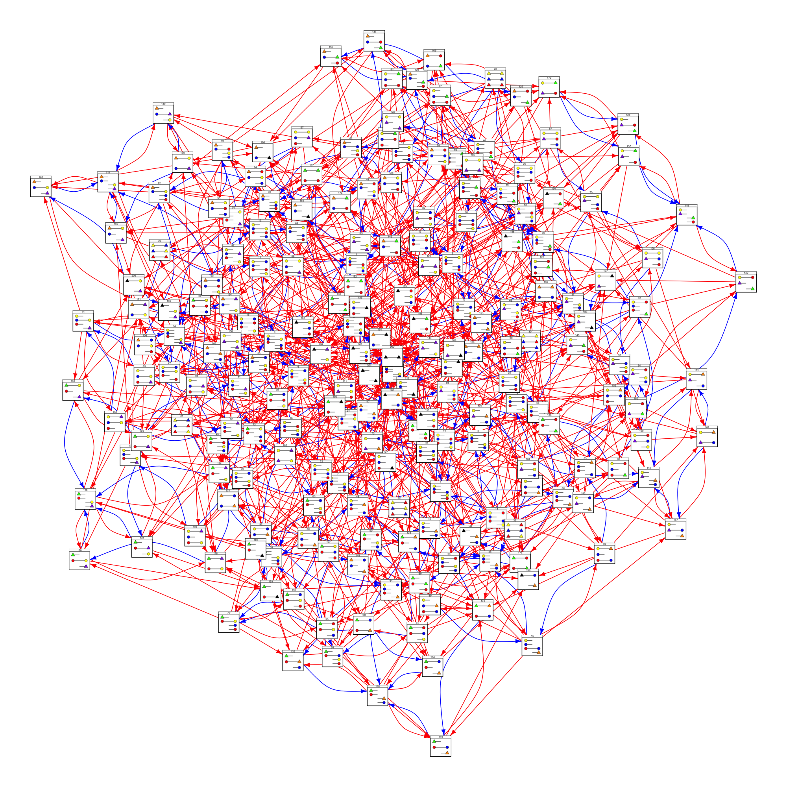
The CTMCs

Slide 16
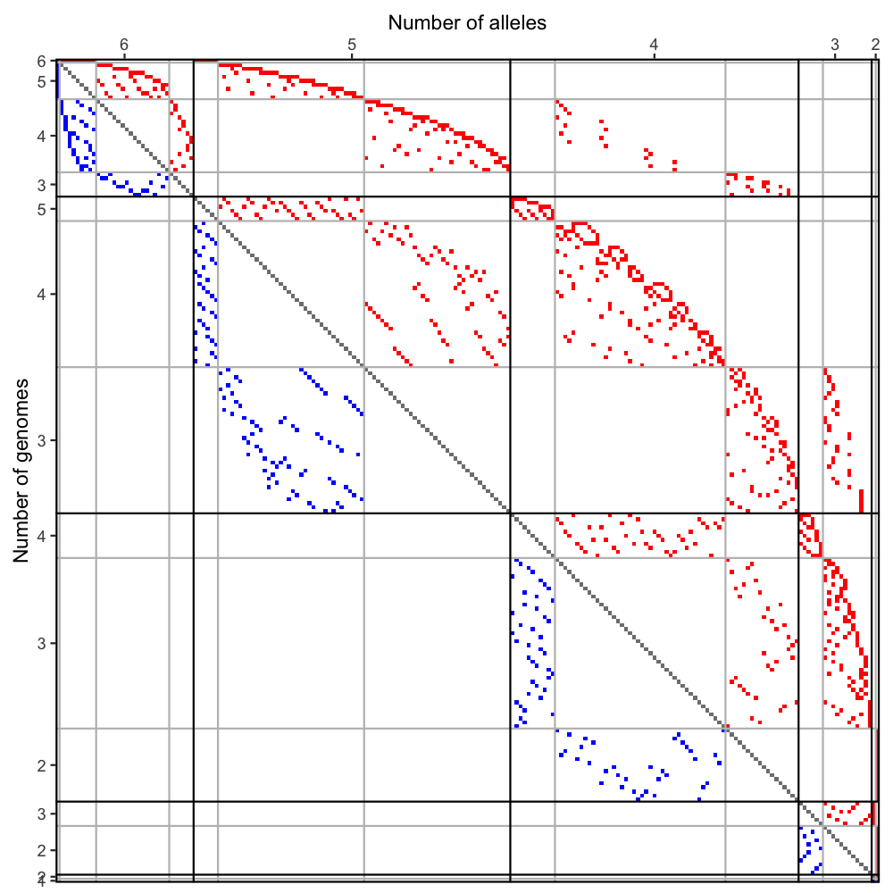
The CTMCs

Slide 17
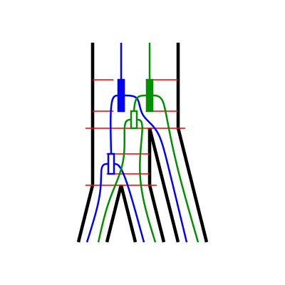
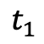
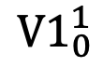
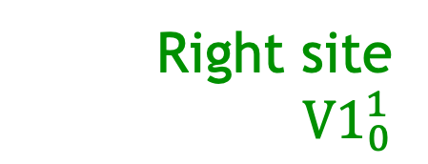
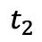
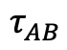
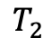
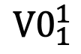

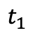
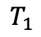
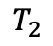
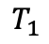
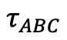
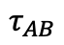
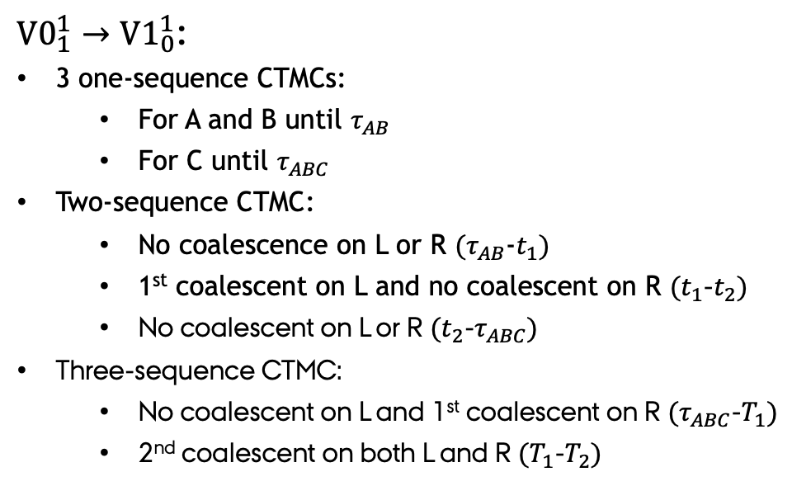
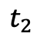
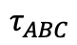
The transition probability matrix
Right site
${V1}_{0}^{1}$
Left site
Right site
Left site
$${V0}_{1}^{1}$$
${V0}_{1}^{1}→{V1}_{0}^{1}$:
3 one-sequence CTMCs:
For A and B until $τ_{AB}$
For C until $τ_{ABC}$
Two-sequence CTMC:
No coalescence on L or R $(τ_{AB}$-$t_{1})$
1st coalescent on L and no coalescent on R $(t_{1}$-$t_{2})$
No coalescent on L or R $(t_{2}$-$τ_{ABC})$
Three-sequence CTMC:
No coalescent on L and 1st coalescent on R $(τ_{ABC}$-$T_{1})$
2nd coalescent on both L and R $(T_{1}$-$T_{2})$
$${V0}_{1}^{1}$$
$${V1}_{0}^{1}$$
$$T_{2}$$
$$T_{2}$$
$$T_{1}$$
$$T_{1}$$
$$τ_{ABC}$$
$$τ_{ABC}$$
$$t_{2}$$
$$t_{2}$$
$$t_{1}$$
$$t_{1}$$
$$τ_{AB}$$
$$τ_{AB}$$

Slide 18
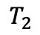
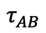
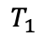
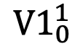
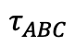
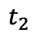
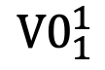

The transition probability matrix
Right site
${V1}_{0}^{1}$
Left site
$${V0}_{1}^{1}$$
Left site
Right site
${V0}_{1}^{1}→{V1}_{0}^{1}$:
3 one-sequence CTMCs:
For A and B until $τ_{AB}$
For C until $τ_{ABC}$
Two-sequence CTMC:
No coalescence on L or R $(τ_{AB}$-$t_{1})$
1st coalescent on L and no coalescent on R $(t_{1}$-$t_{2})$
No coalescent on L or R $(t_{2}$-$τ_{ABC})$
Three-sequence CTMC:
No coalescent on L and 1st coalescent on R $(τ_{ABC}$-$T_{1})$
2nd coalescent on both L and R $(T_{1}$-$T_{2})$
$${V0}_{1}^{1}$$
$${V1}_{0}^{1}$$
$$T_{2}$$
$$T_{1}$$
$$T_{2}$$
$$τ_{ABC}$$
$$T_{1}$$
$$τ_{ABC}$$
$$t_{2}$$
$$t_{2}$$
$$t_{1}$$
$$t_{1}$$
$$τ_{AB}$$
$$τ_{AB}$$

Slide 19








The transition probability matrix
Right site
${V1}_{0}^{1}$
Left site
$${V0}_{1}^{1}$$
Left site
Right site
${V0}_{1}^{1}→{V1}_{0}^{1}$:
3 one-sequence CTMCs:
For A and B until $τ_{AB}$
For C until $τ_{ABC}$
Two-sequence CTMC:
No coalescence on L or R $(τ_{AB}$-$t_{1})$
1st coalescent on L and no coalescent on R $(t_{1}$-$t_{2})$
No coalescent on L or R $(t_{2}$-$τ_{ABC})$
Three-sequence CTMC:
No coalescent on L and 1st coalescent on R $(τ_{ABC}$-$T_{1})$
2nd coalescent on both L and R $(T_{1}$-$T_{2})$
$${V0}_{1}^{1}$$
$${V1}_{0}^{1}$$
$$T_{2}$$
$$T_{2}$$
$$T_{1}$$
$$τ_{ABC}$$
$$T_{1}$$
$$τ_{ABC}$$
$$t_{2}$$
$$t_{2}$$
$$t_{1}$$
$$t_{1}$$
$$τ_{AB}$$
$$τ_{AB}$$

Slide 20








The transition probability matrix
Left site
Right site
Right site
${V1}_{0}^{1}$
Left site
$${V0}_{1}^{1}$$
$${V0}_{1}^{1}$$
$${V1}_{0}^{1}$$
${V0}_{1}^{1}→{V1}_{0}^{1}$:
3 one-sequence CTMCs:
For A and B until $τ_{AB}$
For C until $τ_{ABC}$
Two-sequence CTMC:
No coalescence on L or R $(τ_{AB}$-$t_{1})$
1st coalescent on L and no coalescent on R $(t_{1}$-$t_{2})$
No coalescent on L or R $(t_{2}$-$τ_{ABC})$
Three-sequence CTMC:
No coalescent on L and 1st coalescent on R $(τ_{ABC}$-$T_{1})$
2nd coalescent on both L and R $(T_{1}$-$T_{2})$
$$T_{2}$$
$$T_{2}$$
$$T_{1}$$
$$T_{1}$$
$$τ_{ABC}$$
$$τ_{ABC}$$
$$t_{2}$$
$$t_{1}$$
$$t_{2}$$
$$τ_{AB}$$
$$t_{1}$$
$$τ_{AB}$$

Slide 21

The transition probability matrix
Joint probability matrix
Left site
Right site

Slide 22

The transition probability matrix
Joint probability matrix
Transition probability matrix
Left site
Left site
Right site
Right site

Slide 23













The transition probability matrix
Transition probability matrix
$$ρ_{ABC}$$
$$θ_{ABC}$$
$$n_{ABC}$$
$$ρ_{AB}$$
$$θ_{AB}$$
$$n_{ABC}$$
$$τ_{AB}$$
$$ρ_{C}$$
$$θ_{C}$$
$$τ_{c}$$
Left site
$$τ_{A}$$
$$ρ_{A}$$
$$ρ_{B}$$
$$τ_{B}$$
$$θ_{A}$$
$$θ_{B}$$
Right site

Slide 24

Simulating from the model

Slide 25
Discussion
Current state:
Transition probability matrix calculated

Slide 26
Discussion
Current state:
Transition probability matrix calculated
Future work:
Optimize transition probability matrix
Emission probabilities.
Chose and code optimization procedure.
Analyze simulated data.

Slide 27
Discussion
Current state:
Transition probability matrix calculated
Future work:
Optimize transition probability matrix
Emission probabilities.
Chose and code optimization procedure.
Analyze simulated data.
Future perspective:
ILSMC is flexible:
Different parameterization per interval
ILSMC is extensible:
ILS and introgression.

Slide 28




Acknowledgements
References
Dutheil, J. Y., Ganapathy, G., Hobolth, A., Mailund, T., Uyenoyama, M. K., & Schierup, M. H. (2009). Ancestral population genomics: the coalescent hidden Markov model approach. Genetics, 183(1), 259-274.
Mailund, T., Dutheil, J. Y., Hobolth, A., Lunter, G., & Schierup, M. H. (2011). Estimating divergence time and ancestral effective population size of Bornean and Sumatran orangutan subspecies using a coalescent hidden Markov model. PLoS genetics, 7(3), e1001319.
Li, H., & Durbin, R. (2011). Inference of human population history from individual whole-genome sequences. Nature, 475(7357), 493-496.
Mikkel H. Schierup
Asger Hobolth
Contact
Julien Y. Dutheil
Iker Rivas-González – PhD Student
Bioinformatics Research Centre (BiRC) Aarhus University
irg@birc.au.dk
@irg_bio
My co-workers at BiRC

